Slide 1
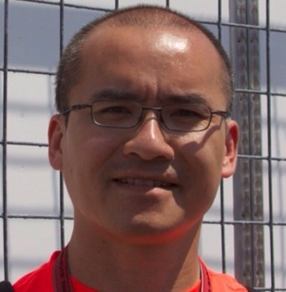
Alex screwed up the LAB download package!
I’m a sad panda.
WiFi SSID (*not* for Internet) agile-firestarter
Download URL http://agile/

